Slide 1
The Acts of the Apostles
Acts 28 – Paul’s Journey To Rome
Sunday – January 5, 2019

Slide 2
Paul in Rome
Paul was in prison in Rome from 61-63 AD
  Nero was emperor of Rome from 54-68 AD
  Nero was the one who would have heard his case

Slide 3
Overview – Paul in Rome
What happened to Paul after being imprisoned in Rome? (Prison Epistles)
  Many obstacles. Ephesians 6:18-19; Colossians 4:2-4
  Much success.
    Onesimus. (Philemon)
    Palace guards. (Philippians 1:12-14)
    Effect on the disciples and others. (Philippians 1:14-18)
  Many companions, though imprisoned.
    Timothy (Opening salutations of Colossians, Philemon, and Philippians)
    Aristarchus and Epaphras were fellow-prisoners (Colossians 4:10; Philemon 23)
    Mark and Barnabas (Colossians 4:10)
    Luke and Demas (Colossians 4:14)
    Jesus called Justus (Colossians 4:11)

Slide 4
Paul in Rome
Paul was busy in Rome in spite of being a prisoner.
  Preached to all who would come and hear. Paul preached to those in high places.
  (Acts 9:15; Philippians 1:12-18; 4:22)
  Epaphras visited Paul from the congregation at Colossae. (Colossians 1:2-8)

Slide 5
Paul in Rome
  Paul wrote Colossians and sent it by the hands of Tychicus and Onesimus (Colossians 4:7-9).
  They also carried the book of Ephesians to the church at Ephesus.
  These two books (Ephesians and Colossians) are companion lessons.
    Ephesians stresses the church as the fullness of Christ.
    Colossians stresses the deity of Christ, the fullness of deity.

Slide 6
Paul in Rome
Converted Onesimus
  A runaway slave who had been put in prison
  Paul converted him and sent him back to Philemon
    Philemon was a personal friend of Paul’s, a faithful Christian in the congregation at Colossae
  Paul wrote the book of Philemon to him to ask him to receive Onesimus again as a servant – AND as a brother in Christ as well (Colossians 4:7-18; Philemon)

Slide 7
Paul in Rome
Epaphroditus
  Brought Paul a gift from the church at Philippi (63 AD) (Philippians 1:1; 2:25).
    Paul sent a return letter to the brethren expressing thanks for the gift and for all the brethren there.
    Hoped to be released soon and visit with them (Philippians 2:23-24).

Slide 8
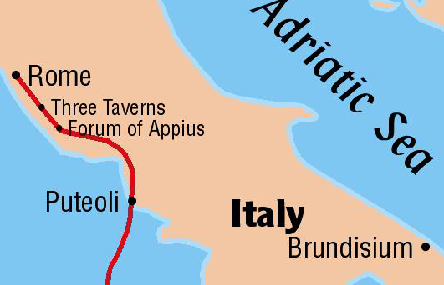
Paul wrote letters from Rome
  Colossians
  Ephesians
  Philemon
  Philippians
Prison
Epistles
Tychicus and Onesimus carried the Colossian letter and the Ephesian letter back to the respective congregations
Onesimus carried the letter to Philemon
Epaphroditus carried the letter to the Philippians

Slide 9
Paul in Rome
Results of Paul’s appeal to Caesar. Acts does not reveal anything about the trial.
  Evidence indicates at the end of 2 years, Paul was released (Philemon 22; Philippians 1:25; Philippians 2:23-24).

Slide 10
Paul in Rome
Evidence for Paul’s release … No place can be found in preceding history for:
  Leaving Timothy in Ephesus while Paul was in Macedonia. 1 Timothy 1:3
  Leaving Titus in Crete. Titus 1:5
  Paul’s visit to Miletus when he left Trophimus there sick. 2 Timothy 4:20
  Paul’s visit to Nicopolis to winter. Titus 3:12
  Told the Romans he hoped to go to Spain someday (Romans 15:24), but no evidence that he ever did.

